Slide 1

TEAM FRONTENAC MMA 831 Marketing Analytics Professor Masoum Mosmer November 27, 2022
iFood: Delivery

Slide 2
01
02
03
04
Company Background
Customer Segmentation
Campaign Response Model
Recommendation
What is iFood?
Who are the customers?
How to target iFood's customers?
What are the next steps?

Slide 3
iFood
60M+ orders delivered monthly
270K+ partnered restaurants
200K couriers
4K employees
Background
Brazilian online food ordering and delivery platform. Founded in 2011 and operates in Brazil and Colombia.
iFood Delivery

Slide 4


Objectives
Understand customers better in order to create segment specific strategies
Target customers in the next marketing campaign in a way that maximizes profit

Slide 5
Exploratory Data Analysis
Categorical Features
Numerical Features
Marital status, education, and accept campaigns
User demographics: age, income
Transaction data: number of purchases and amount spent on products
Notes:
The data contained a mixture of categorical and numerical variables.
The categorical features such as marital status, education, and accept campaigns were already encoded as dummy variables.
The numerical features contained more demographic data as well as transaction data.
We used this data to create customer segmentation profiles using k-means clustering.

Slide 6
Customer Segmentation
Low Income – Healthy Eaters
Low Income – Heavy Drinkers
Retirees
Middle Class Families
Income: BRL 31k
Age: 42
Spend: BRL 101
Most Fruits & Least Meats
Income: BRL 40k
Age: 44
Spend: BRL 130
Most Wine & Least Sweets
Income: BRL 60k
Age: 60
Spend: BRL 740
Most Wine & Least Fruits
Website orders
Income: BRL 77k
Spend: BRL 1349
Most Meat & Least Sweets
More than 1 kid on average
Notes:
We identified 4 clusters in our data.
The first 2 are fairly similar. They have similar incomes and similar ages. Where they differ is what products they spend the most money on. Cluster 1 spends the most on fruits while cluster 2 spends the most on wine.
Cluster 3 are the retirees – these people are older, have a higher income than the first 2 clusters and higher spending amounts. They make more purchases via online shopping than the other clusters.
Cluster 4 are middle class families. This is the group that has the most kids, as well as the highest income and highest spend.
Next, Annie will walk us through the model development process.

Slide 7
Model Development Process
Phase 1
Phase 2
Phase 3
Phase 4
Data Cleaning
Missing Values
Feature Engineering
New Feature: Frequency of Purchases
Scale: Frequency, Income, Mnt Total, Recency
Build Model
K-Means Clustering, Hierarchy, Random Forest, Neural Network
Hyper Tuning
Elbow Method to find best K, Random Search
Done
Notes:
Phase 1:Data Cleaning: We verified there are no missing values
Phase 2:Feature Engineering:
Add ‘Frequency” = sum of purchases across all channels/ customer days
Scale “Frequency” , ”Income”, ”Mnt Total”, ”Recency” -- convert into the same units (days, dollars)
Phase 3:Build Model: K-Means Clustering, Hierarchy for customer segments; then Random Forest, Neural Network for response model
Phase 4: Hyper Tunning: Use Elbow Method to find the best K value; Use Random Search to tune random forest hyperparameters – helps identify best hyperparameter values

Slide 8
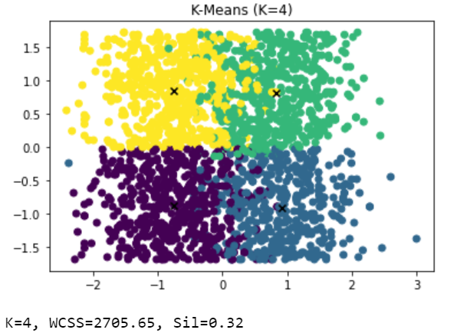
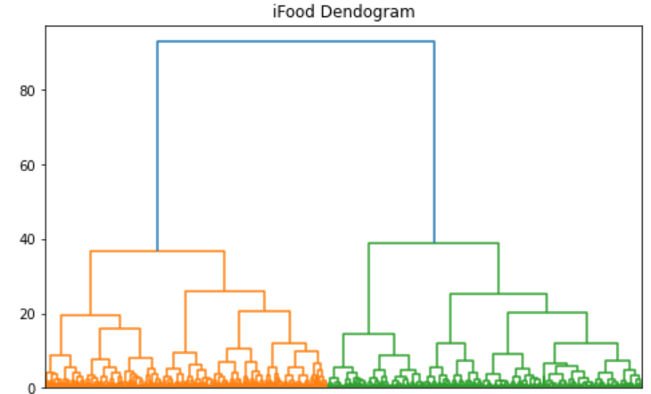
Results: Clustering Model
K Means Clustering
Hierarchical Clustering
N_clusters = 4
Notes:
Look at silhouette score (Distance of each cluster) and inertia score. We determine that 3,4 clusters might works the best for our dataset.

Slide 9
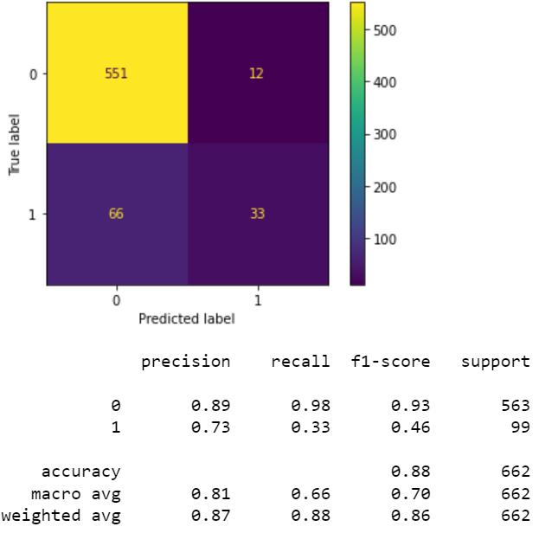
Results: Campaign Response Model
Target Variable
1
Accept the offer in last campaign
(1 – Accept, 0 – No response)
All customers predicted as ‘True’ by the model will be targeted through the Campaign Response model
2
Objective was to maximize customers in true positive box at an optimum precision rate
3
Notes:
Precision:The ratio of correct positive predictions to the total predicted positives
Recall: the number of true positives divided by the total number of elements that actually belong to the positive class
F1 score is defined as the harmonic mean between precision and recall. It is used as a statistical measure to rate performance. In other words, an F1-score (from 0 to 9, 0 being lowest and 9 being the highest) is a mean of an individual's performance, based on two factors i.e. precision and recall.
https://www.myaccountingcourse.com/accounting-dictionary/f1-score
Campaign cost spend on false positive customers is undesirable but unavoidable

Slide 10
Cost Benefit Analysis
6x
Model-based approach is expected to give more than six times the profit in comparison to ‘spray and pray’ approach
Notes:
Cost per cust: BRL 5
Revenue per cust: BRL 80 (2 month of sales)
WITHOUT MODEL CONVERSION RATE – 7%

Slide 11
Recommendation
Strategic Marketing Decision
Primary focus on 2 customer segments - ‘Retirees’ and ‘Middle Class Family’
Website based promotions and offers for ‘Retirees’
‘Market-Basket’ analysis on ‘Middle Class Family’
Algorithmic Marketing Decision
Apply model-based approach to target customers with high-likelihood to respond
Notes:
1.a. Focus on retirees and middle class as average spend much higher than other segments
1.b. Target retirees through web based promotions as they make a lot of purchase over the web
1.c. Since more number of family members (kids) so a market basket analysis could yield higher value per transaction

Slide 12
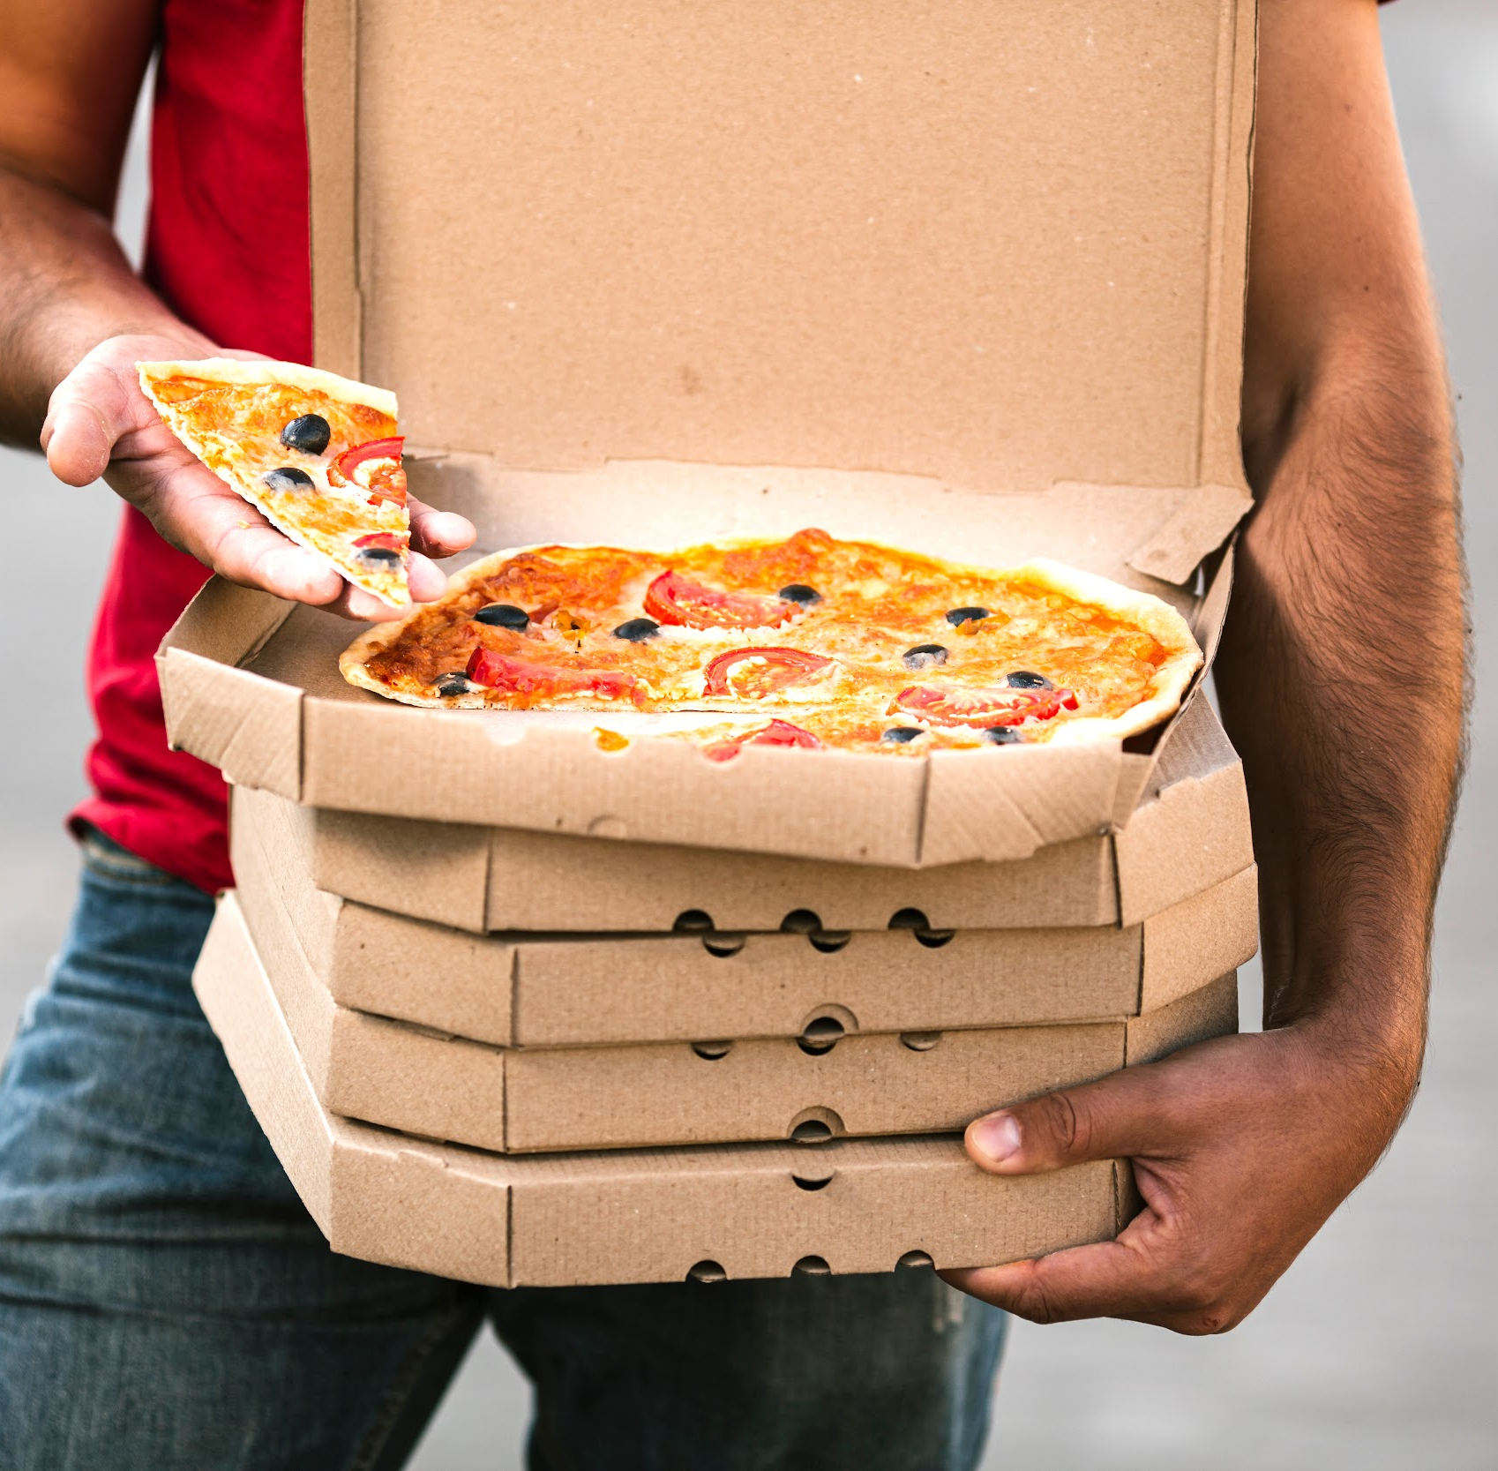
Thanks!
Questions?

Slide 13
Cost Benefit Analysis
 | #Cust - 500k |  | #Cust - 1 million |  | #Cust - 2 million
 | No Model | Model | No Model | Model | No Model | Model
Revenue | 2.8 | 2.0 | 5.6 | 3.9 | 11.2 | 8.0
Cost | 2.5 | 0.2 | 5 | 0.3 | 10.0 | 0.7
Profit | 0.3 | 1.8 | 0.6 | 3.6 | 1.2 | 7.3
All values of revenue, cost and profit in BRL million

Slide 14
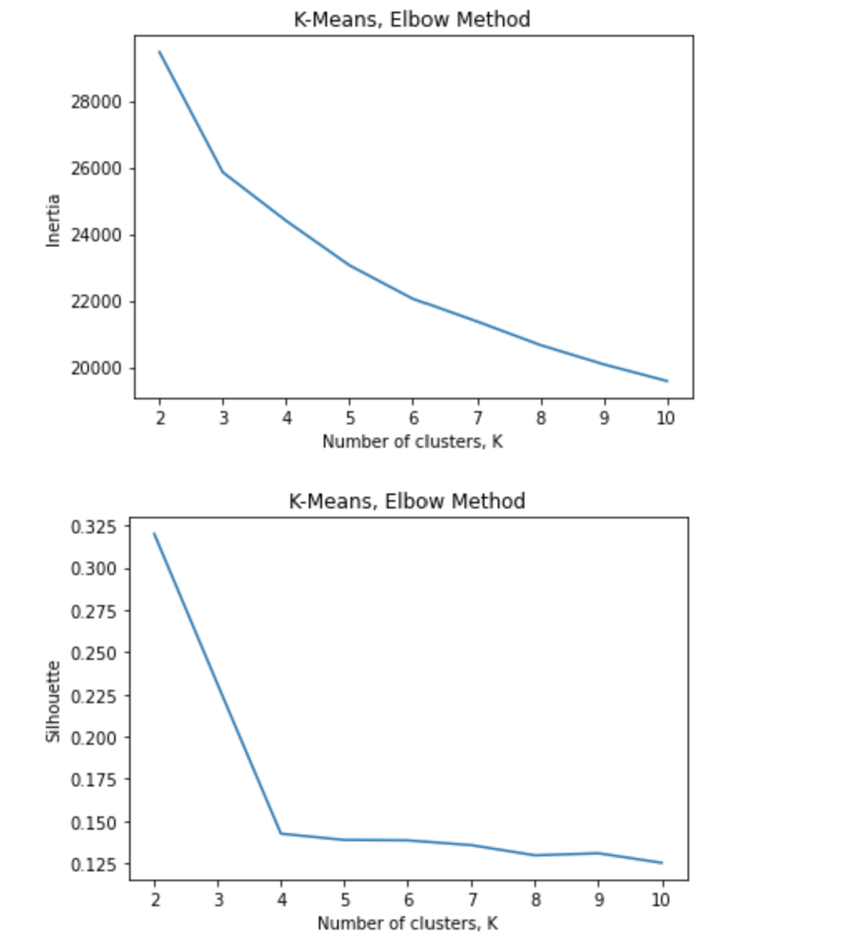
Define k-cluster: Elbow Method

